Slide 1

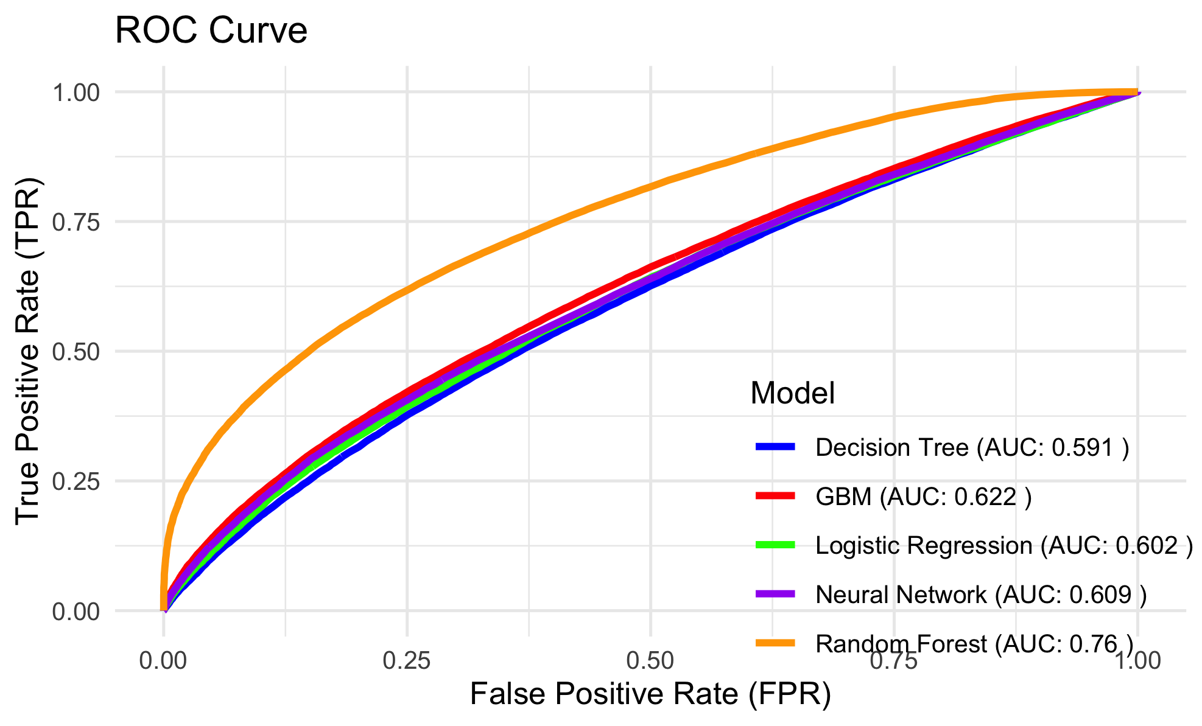
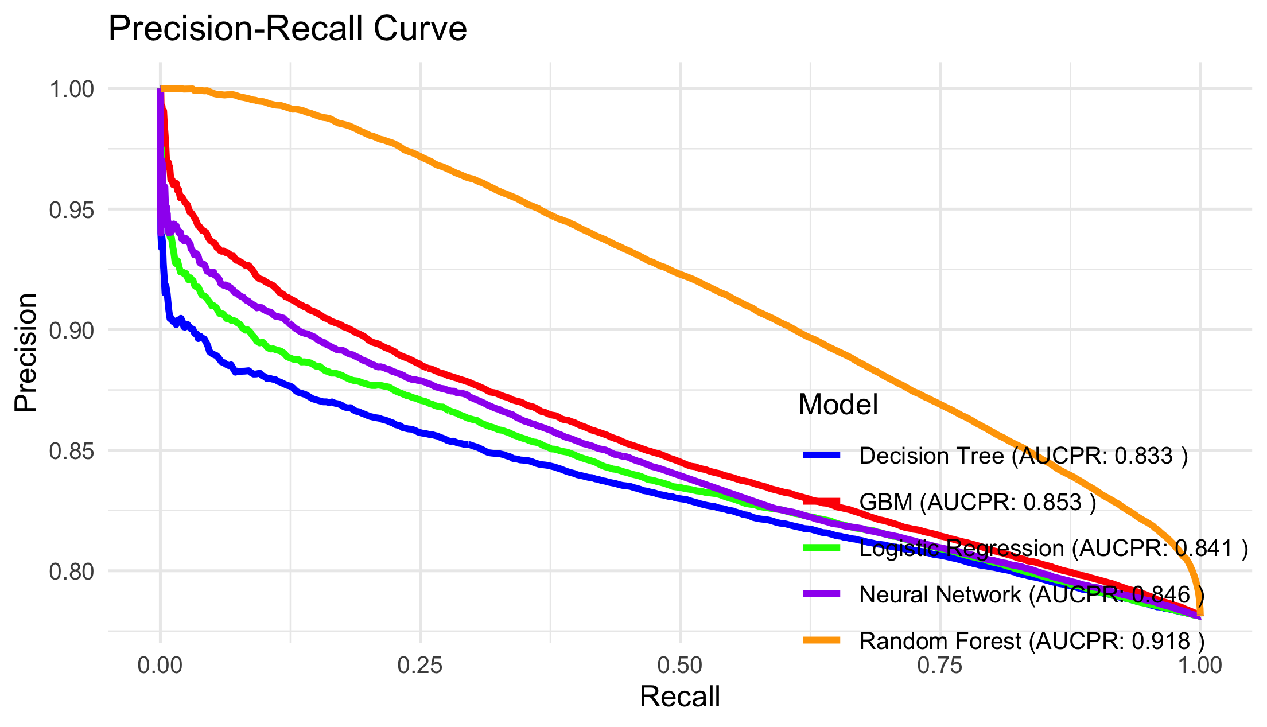
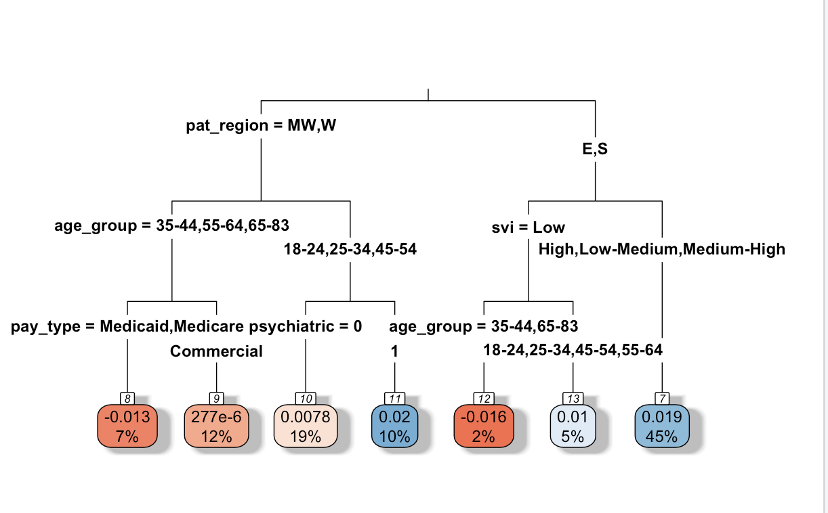
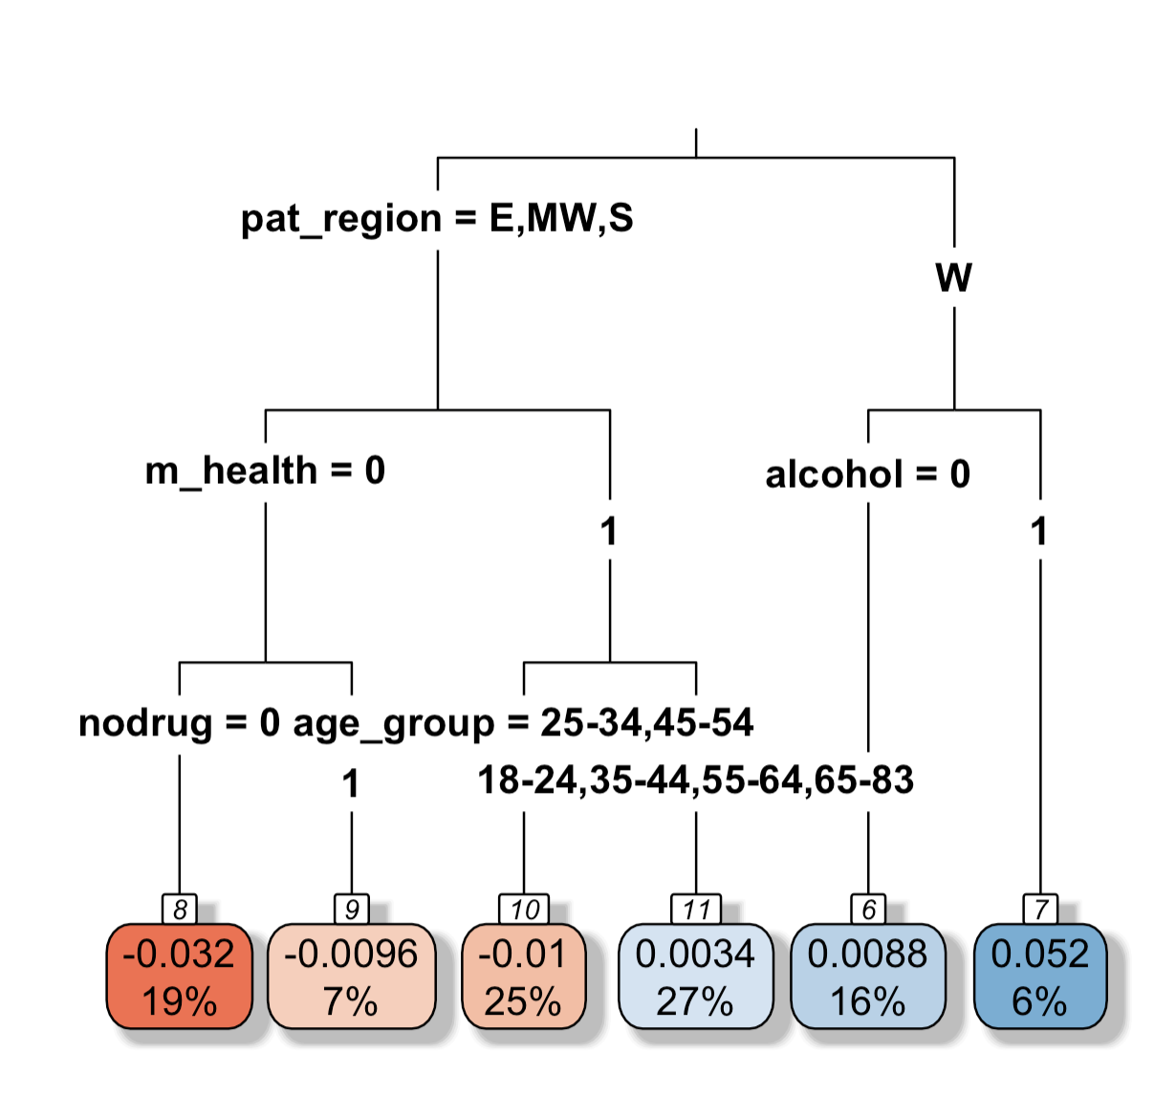
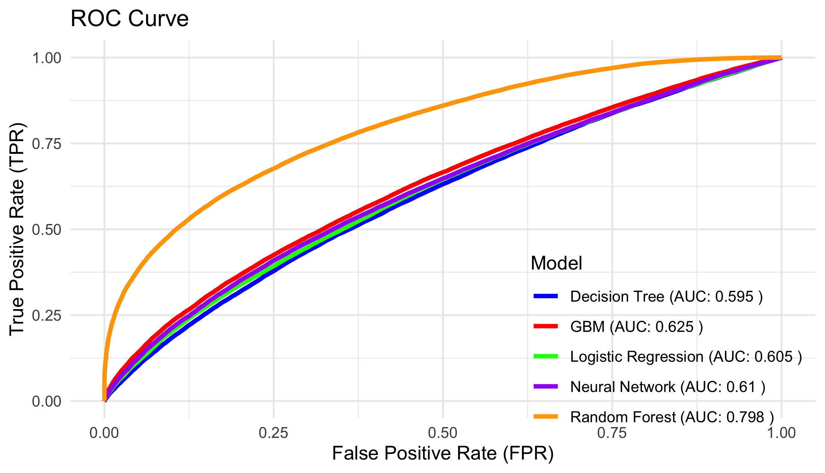
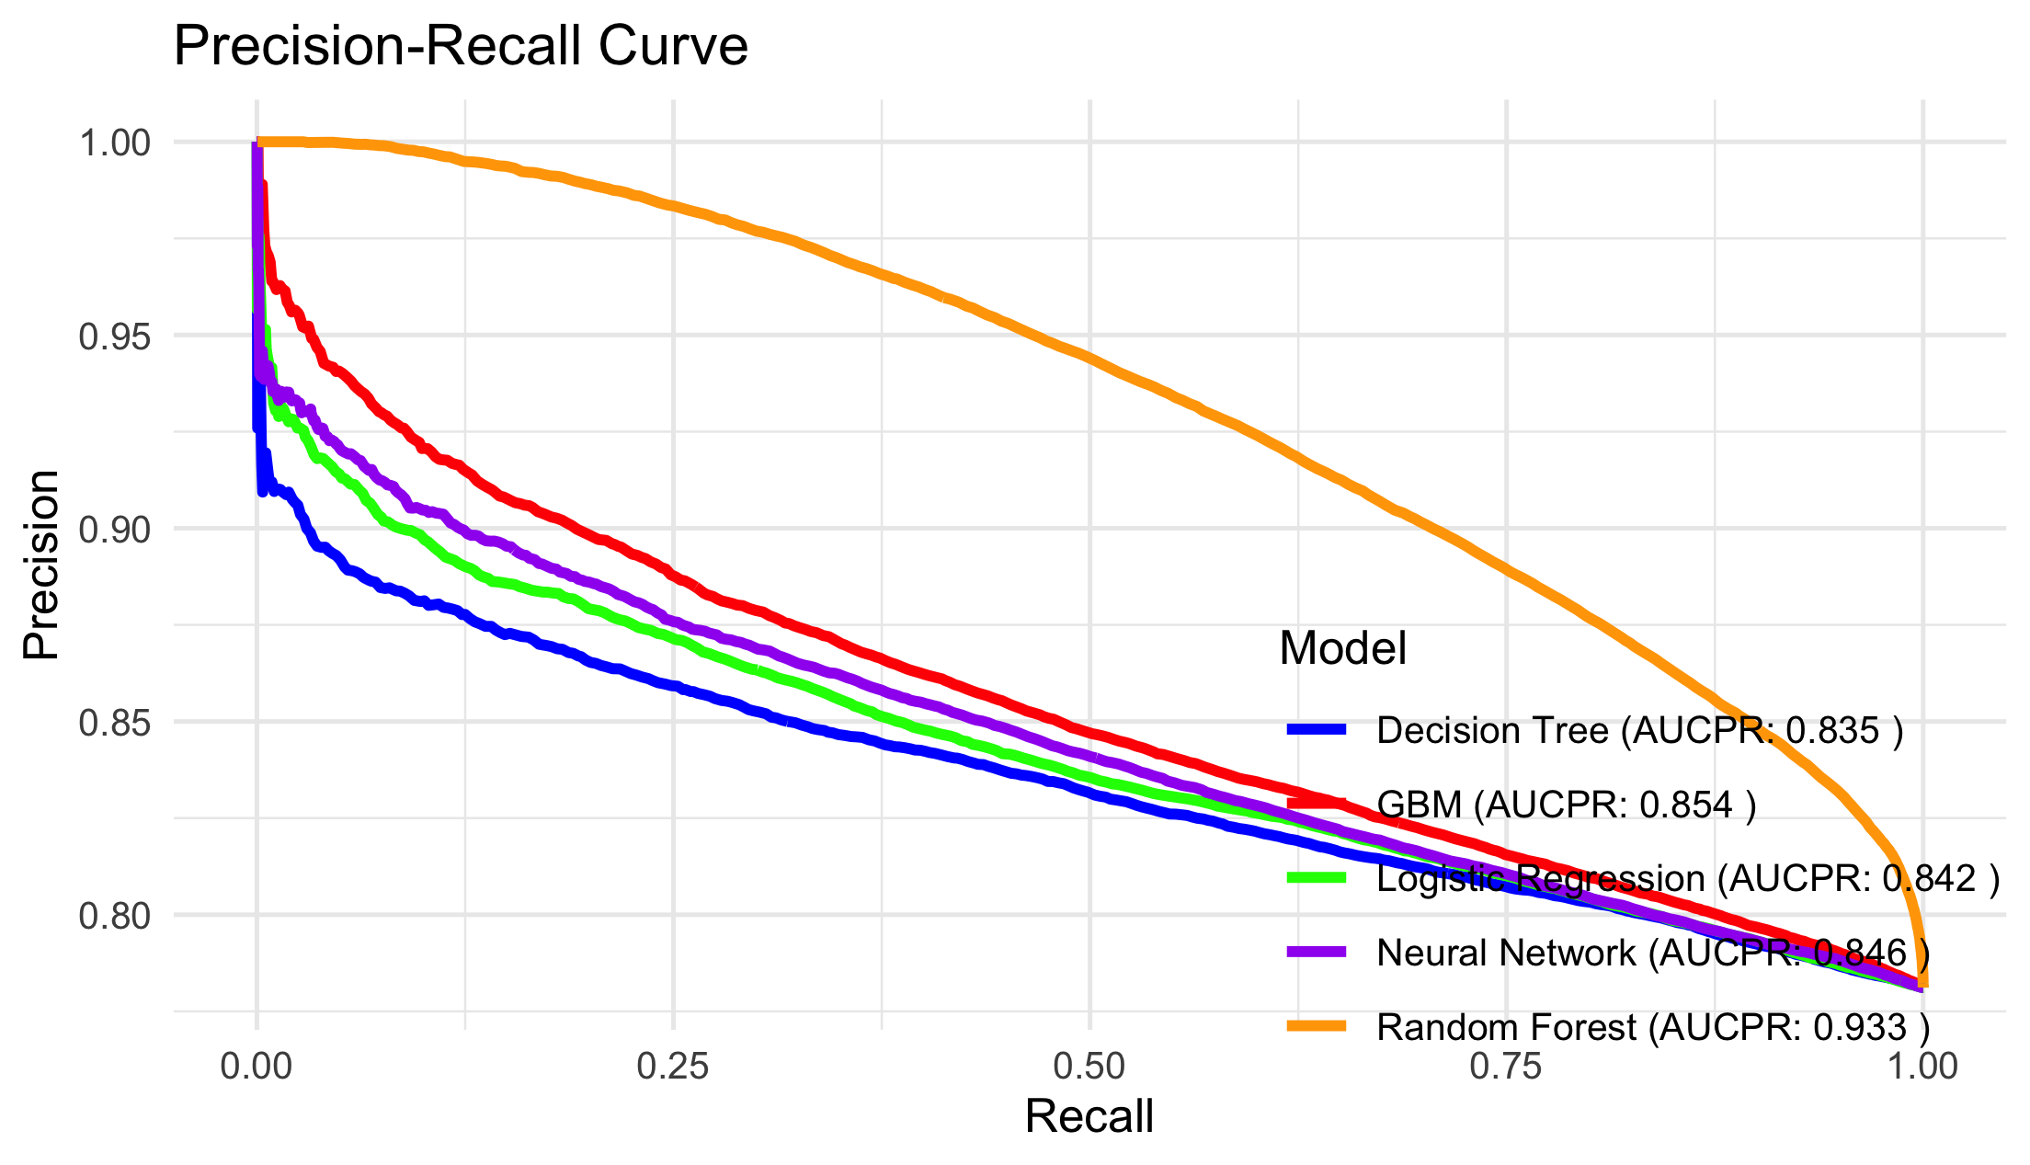
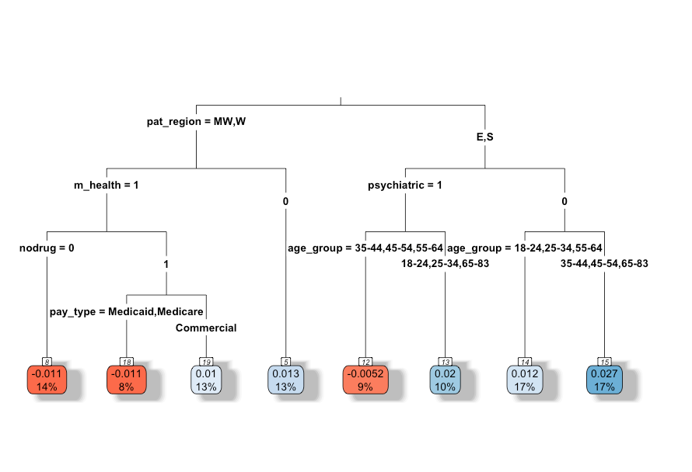
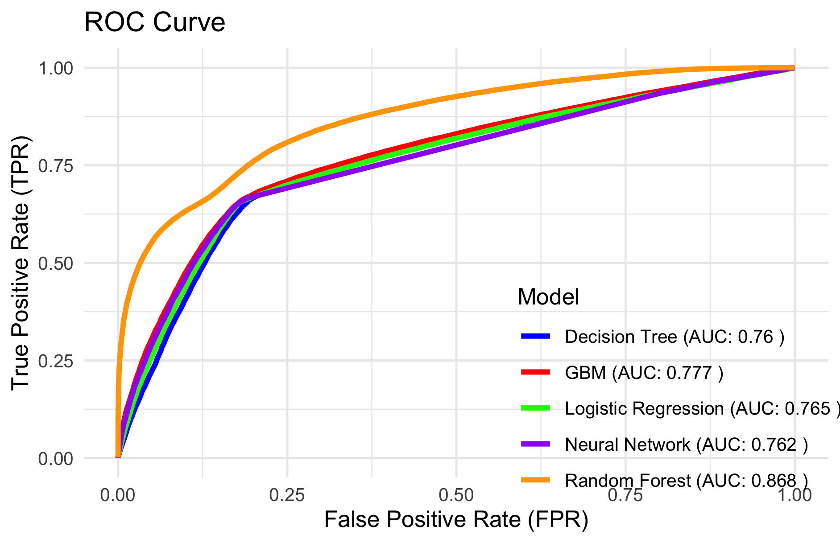
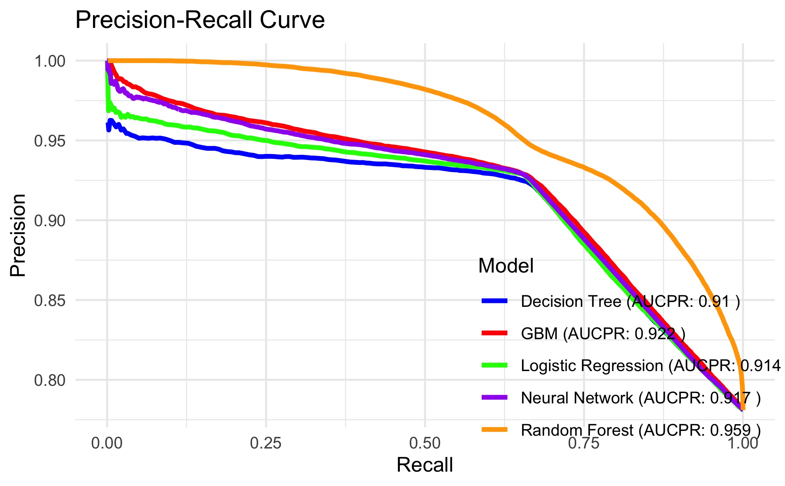
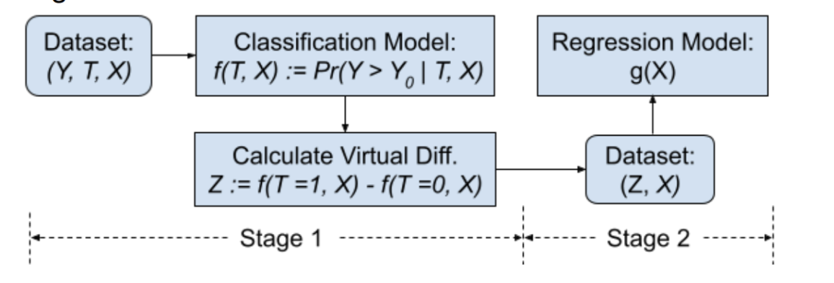


Subgroup Identification of Disparities in Treatment Discontinuation in Opioid Use Disorder Using a Virtual Twins Machine Learning Model
Wanru Guo¹, Paula Jaimes Buitron², Yanmin Gong³, Yuanxiong Guo⁴, Carolina Vivas Valencia², Cici Bauer¹
¹Department of Biostatistics and Data Science, School of Public Health, UTHealth, ²Department of Biomedical Engineering, University of Texas at San Antonio, ³Department of Electrical and Computer Engineering, University of Texas at San Antonio, ⁴Department of Department of Information Systems and Cyber Security, University of Texas at San Antonio; Correspondance: wanru.guo@uth.tmc.edu
INTRODUCTION
RESULTS
Opioid use disorder (OUD) has been a public health crisis in the US, leading to significant mortality and morbidity. Despite the effectiveness of buprenorphine in treating OUD, treatment discontinuation remains a critical challenge, often resulting in relapse and overdose. Understanding the key factors that contribute to discontinuation is essential for improving treatment outcomes. This study leverages the large-scale IQVIA PharMetrics database (2006-2023) and machine learning models to identify predictors of buprenorphine treatment discontinuation.
Figure 3. Prediction Performance of ML Models in Stage 1. (PDC90: Proportion of Days Covered by Treatment in First 90 Days From Start of the First Episode)
Figure 4. Subgroup Identification for Gender Disparities. (Z = Prf(Sex=F, Xi) - Prf (Sex=M, Xi))
Figure 6. Subgroup Identification For Health Insurance Disparities
(Z = Prf(Commercial & Self-insured, Xi) – Prf(Medicare & Medicaid, Xi)
ROC Curve (Baseline Predictors)
PR Curve (Baseline Predictors)
Commercially and self-insured patients have higher risk of discontinuation than Medicare/Medicaid.
This is more pronounced in the West and patients with alcohol use (6%), and is mitigated in patients in other regions, without mental health conditions and not using non-opioid drugs (19%).
METHODS
Buprenorphine treatment episodes were identified using a 14-day gap prescription data to define a new episode.
Discontinuation was defined as episodes lasting <180 days with no gaps >7 days.
Features including procedural, diagnostic, demographic, and social determinants were engineered for each episode.
A two-stage virtual-twins model identified vulnerable subgroups based on gender, SVI and insurance types.
Stage 1 applied ML methods (Random forest, GBM, MLP, etc.) to classify discontinuation and selected the best-performing model for Stage 2.
Stage 2 used 20% of data to estimate counterfactual treatment effects and regression trees on the remaining data to identify subgroups with differing responses.
Figure 1. Workflow in Creating the Analytical Dataset.
ROC Curve (Baseline Predictors + SVI)
PR Curve (Baseline Predictors + SVI)
Females have higher risk of discontinuation than males.
In East and South regions, this effect is more pronounced in higher social vulnerability groups (45% of the population)
Sex disparity is mitigated for patients in the Midwest/West regions aged 35-44 and 55+ with Medicare/ Medicaid insurance (7%).
For those patients with co-existing mental health conditions, this effect depends on age.
CONCLUSIONS
Figure 5. Subgroup Identification for SVI Disparities
(Z = Prf (SVI = High, Xi) – Prf (SVI = Low, Xi)
Incorporating SVI and PDC90 improved Model Performance:
C-Statistic increased from 0.595 to 0.798 (SVI) and to 0.868 (PDC90).
AUCPR improved from 0.835 to 0.933 (SVI) reached 0.959 (PDC90).
Subgroup analysis identified disparities treatment discontinuation:
Females and patients with higher SVI faced greater risk of discontinuation.
Insurance disparities were highest in commercially and self-insured patients, particularly in the West.
Roles of mental health diagnoses, non-opioid drug use, and Medicare/Medicaid coverage in mitigating disparities.
These findings inform policies to reduce disparities and improve treatment access and retention.
ROC Curve (Baseline Predictors + SVI + PDC90)
PR Curve (Baseline Predictors + SVI+ PDC90)
Figure 2. Workflow of the Virtual Twins Model
ACKNOWLEDGEMENTS
This research was, in part, funded by the National Institutes of Health (NIH) Agreement No. 1OT2OD032581 and the AIM-AHEAD Consortium.
C-Statistic ranged from 0.591 to 0.760 and AUCPR from 0.833 to 0.918 for models with demographic, diagnostic, and procedural predictors.
Adding SVI improved performance (C-Statistic: 0.595–0.798; AUCPR: 0.835–0.933).
Including PDC (90 days) further enhanced performance (C-Statistic: 0.760–0.868; AUCPR: 0.910–0.959).
Random forest performed best (C-Statistic: 0.760 in the first model; 0.798 with SVI) and was used for disparity analysis in Stage 2.
The risk of discontinuation increases with higher SVI groups.
In East and South regions, the effect is more pronounced for patients without psychiatric services and aged 35–54 or 65+ (17% of the population)
In West and Midwest regions, the SVI disparity is negated for patients with a mental health diagnosis who either do not use non-opioid drugs (14%) or use non-opioid drugs and have Medicare (8%).

